Slide 1
机器学习基本概念

Slide 2
Machine Learning
Training a machine to learn from a data set.

Slide 3
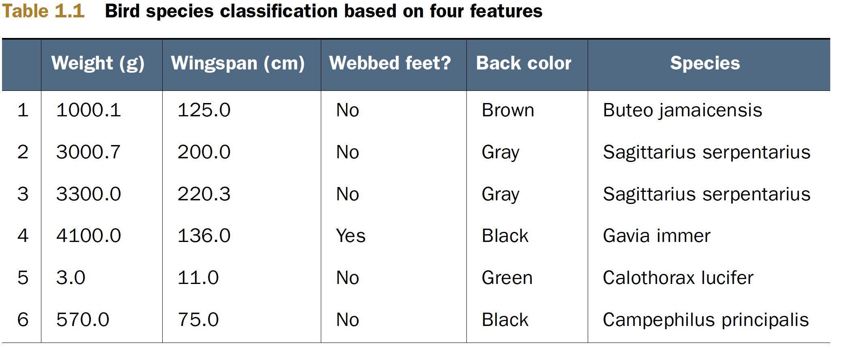
Data set
Q: What knowledge representation should we use for the machine?
Features
Target Variable

Slide 4

Model for Learning
ML model $f(x)$ is an abstraction of real problems with hypothesis in formal.
e.g., linear model

Slide 5
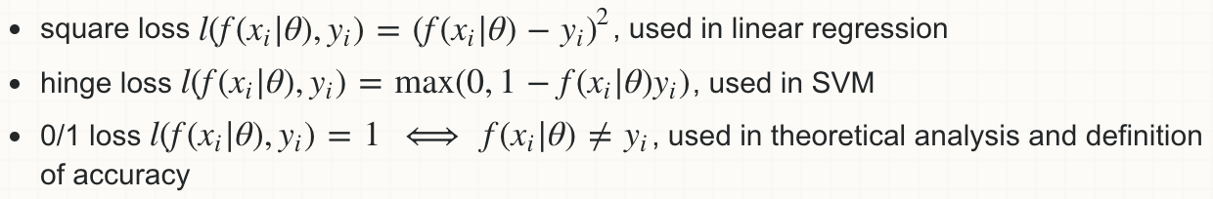
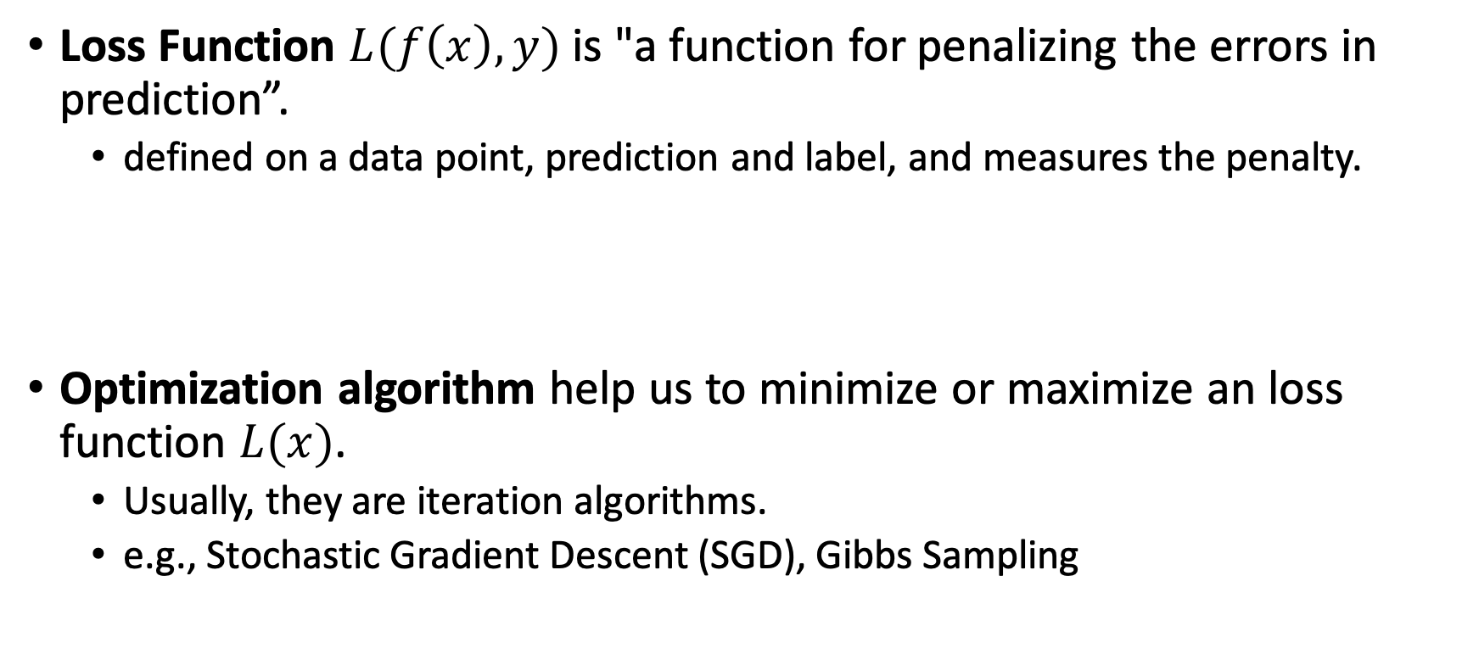
Optimization Algorithm for Training
Loss Function $L(f\left(x\right), y)$ is "a function for penalizing the errors in prediction”.
defined on a data point, prediction and label, and measures the penalty.
Optimization algorithm help us to minimize or maximize an loss function $L(x)$.
Usually, they are iteration algorithms.
e.g., Stochastic Gradient Descent (SGD), Gibbs Sampling
Notes:
https://elitedatascience.com/model-training

Slide 6
Batch Learning
Entire Training Data
Minibatch
Minibatch
Minibatch
Minibatch
One Epoch is when an ENTIRE dataset is passed only ONCE.
Iterations is the number of batches needed to complete one epoch.
Let’s say we have 2000 training examples that we are going to use. We can divide the dataset of 2000 examples into batches of 500 then it will take 4 iterations to complete 1 epoch.

Slide 7
Batch Learning

